Slide 1


Slide 2
Presentation
Presented By
Maheen Nasir (12315)
Soma Nasir(12322)
BSSE-5B
National University of Modern Languages

Slide 3

DRESS SHOP MANAGEMENT SYSTEM

Slide 4
Functional requirements
The customer and shopkeeper shall be able to register himself.
Admin ,customer ,shopkeeper shall be able to login with his username and unique password.
Shopkeeper shall be able to manage products or record of all items.
The customer shall be able to view products and its price.
Admin shall be able to manage customers and shopkeeper.
The customer shall be able to manage cart .
The customer shall be able to give feedback.
The customer shall be able to place order.
Admin shall be able to see order details.
Customer shall be able to pay through credit card, debit card, easy paisa, jazz cash.
Admin shall be able to deliver order through Leopards and TCS

Slide 5
Use Case Diagram
In this section we will discuss the use case of dress shop management system. Uses cases show how the users interact with the system. There are three actors in our system, Customer, Shopkeeper and Admin. We have two secondary actors Payment service and Delivery Service . Each one has its own responsibilities and level of access to the system.

Slide 6
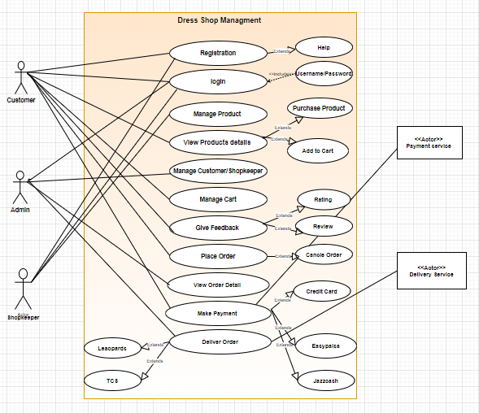
Use Case Diagram

Slide 7
Descriptive Use Case:
In this section we will discuss the descriptive use case of dress management system. Descriptive Uses cases show how the users interact with the system in descriptive form with all previous actors.

Slide 8
1. Descriptive use case of Registration
Use Case Identification
Use Case ID: | UC-01
Use Case Name: | Registration
User/Actors | Customer , Shopkeeper
Preconditions
User shouldn’t have an account.
Primary Flow
Step | User Actions | System Actions
1 | Enter Name, phone number. | 1.1 Save information entered by the user.
2 | Set Password | 2.1 Ask user to put numeric, uppercase letters and special symbols in the password.
3 | Confirm Password | 3.1 Ask user to confirm the password and proceed to the login page.

Slide 9
Conn…
Exception Flow
1 | Internet connection failed | 1.1 Ask user to Re-Enter all the information.
Post conditions
The user created an account successfully.

Slide 10
2. Descriptive use case of Login
Use Case Identification
Use Case ID: | UC-02
Use Case Name: | Login
User/Actor: | Customer, Admin, Shopkeeper
Preconditions
User must have an account.
Primary Flow
Step | User Actions | System Actions
1 | User will enter username and Password to login. | 1.1 Verify the Login Details.
Alternate Flow
Step | User Actions | System Actions
1 | If user enter wrong password. | 1.1 Login Failed and give error message Please renter your password.
2 | If user forgot his password. | 2.1 Ask user to reset password via email or phone number.
3 | User can retry password for only 5 times | 3.1 Pause Login for 60 Sec.

Slide 11
Conn…
Exception Flow
1 | If the system fail to login user. | 1.1 Ask the user to Retry after 2 minutes.
Post conditions
The user login successfully.

Slide 12
3.Descriptive use case of Manage Product
Use Case Identification and History
Use Case ID: | UC-05
Use Case Name: | Manage product.
User/Actor: | Customer, Shopkeeper
Preconditions
User should must be logged into the system.
Basic Flow
Step | User Actions | System Actions
1 | User wants to edit the product | 1.1 System saves the edited data for further.
2 | User wants to delete the product | 2.1 System deletes the deleted item.
3 | User wants to add the product. | 3.1 System adds the item.
Alternate Flow
Step | User Actions | System Actions
1 | None | None
Exception Flow
1 | none | none
Post conditions
User managed the product successfully.

Slide 13
4. Descriptive use case of Feedback
Use Case Identification and History
Use Case ID: | UC-07
Use Case Name: | Giving Feedback
User/Actor: | Customer
Preconditions
User must had a account to give feedback on.
Basic Flow
Step | User Actions | System Actions
1 | User selects the feedback option from feedback through ratting or review | 1.1 User can give more than 1 review but only at one time give ratting.
2 | When the user gets satisfied with his/her feedback | 2.1 then ask for the confirmation message of posting that feedback.
Alternate Flow
Step | User Actions | System Actions
1 | If the user try to use abusive language. | 1.1 then block them for not making further feedbacks.
Post conditions
User have given the feedback successfully

Slide 14
5. Descriptive use case of Make Payment
Use Case Identification and History
Use Case ID: | UC-10
Use Case Name: | Make payment
User/Actor: | Customer , Payment Services
Preconditions
The user must have order.
Basic Flow
Step | User Actions | System Actions
1 | Selects the option from booking via easypaisa/jazzcash or through Credit Card | 1.1 if the user selected easypaisa/jazzcash then ask for this number and password and done the payment, if the user selected credit card then ask for his/her bank account number and password and made the bill accordingly.
Alternate Flow
Step | User Actions | System Actions
1 | If the user wants to cancel his/ her order after payment | 1.1 Allow them and return the money after 1 day.
Exception Flow
1 | If the system failed to response | 1.1 save the information of payment.
Post conditions
User is ready to receive his parcel.

Slide 15
Activity Diagram
In this section we will discuss the activity diagram generated from pre designed use case of dress management system. Activity Diagram elaborates how are use cases carried out in a flow.

Slide 16
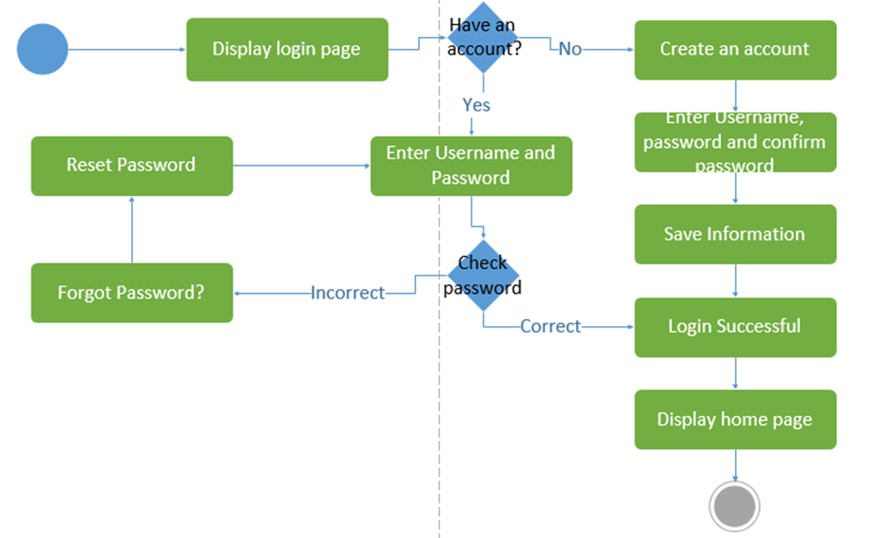
Activity Diagram For Login

Slide 17

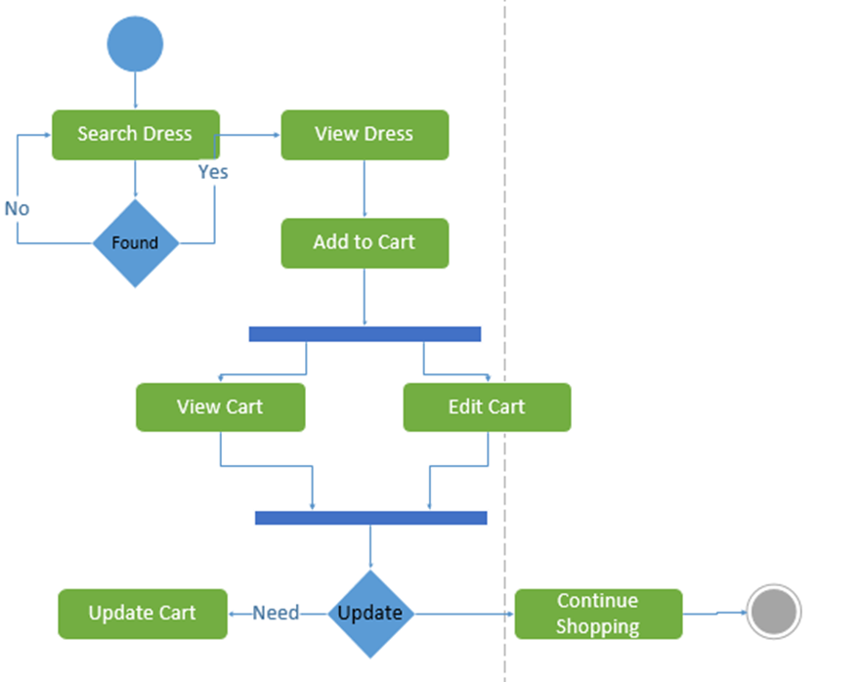
2. Activity Diagram For Manage Cart

Slide 18
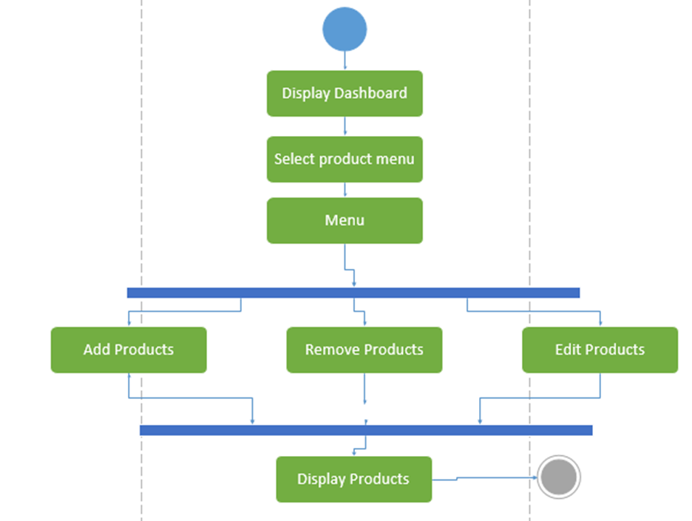

3. Activity Diagram For Manage Product

Slide 19
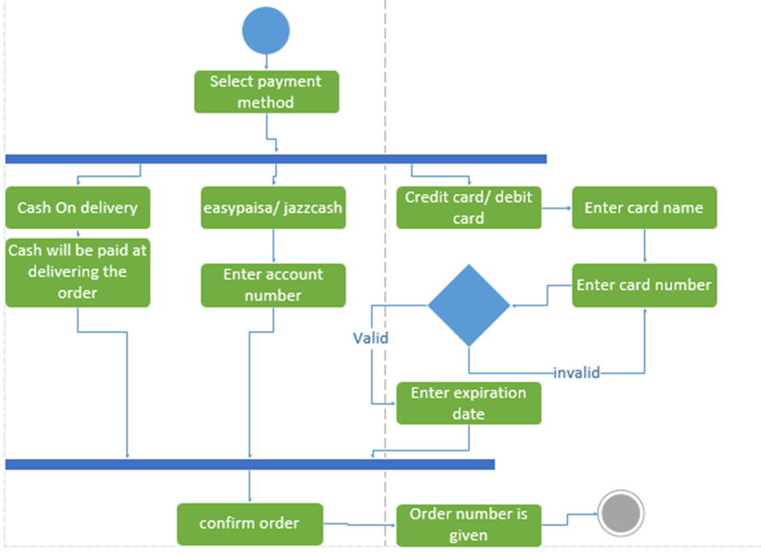
4. Activity Diagram For Make Payment

Slide 20
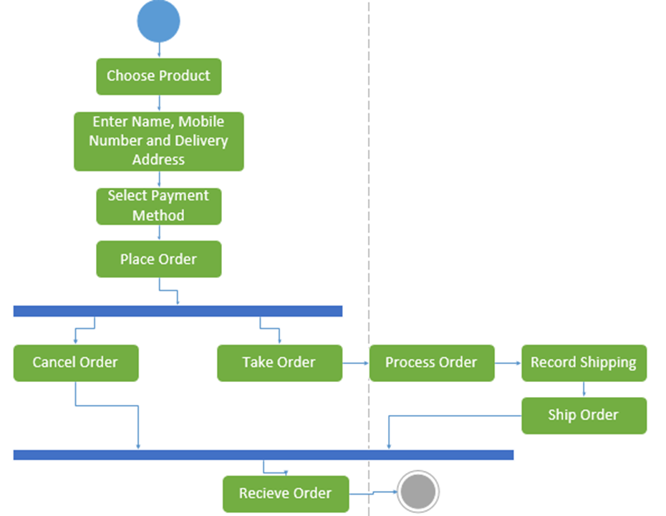
5. Activity Diagram For Place Order

Slide 21
State Machine Diagram:
In this section we will discuss state machine diagram for system. State Machine Diagram explains states of objects drawn from Classes.

Slide 22
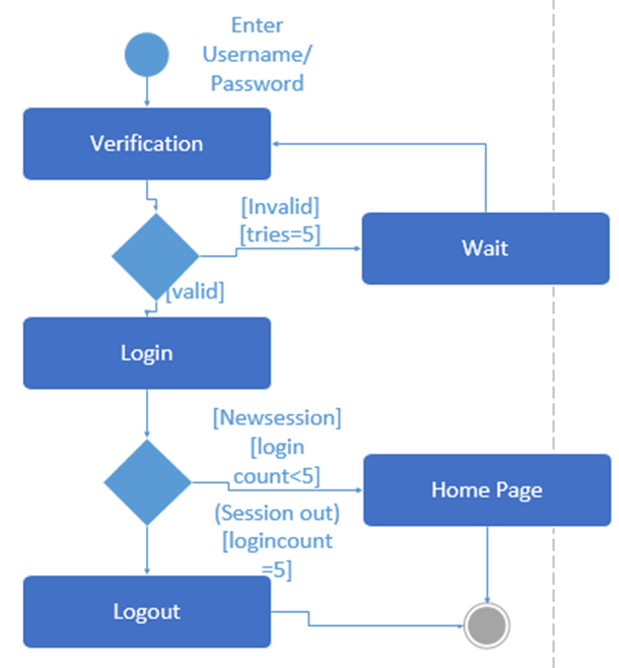
1. State Diagram For Login

Slide 23
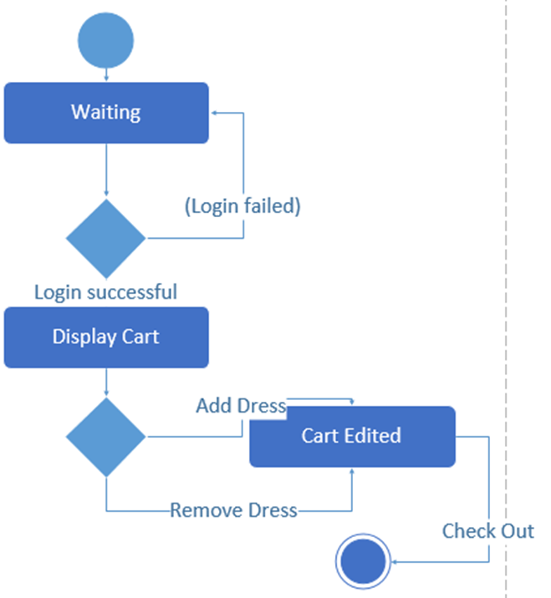
2. State Diagram For Manage Cart

Slide 24
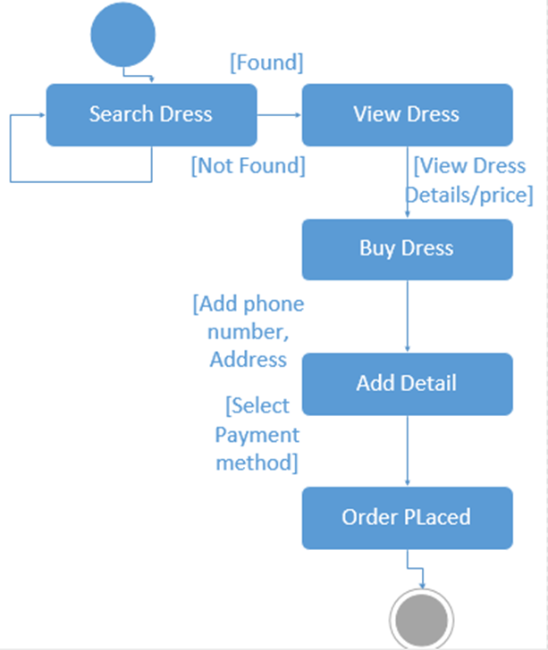
3. State Diagram For Place Order

Slide 25
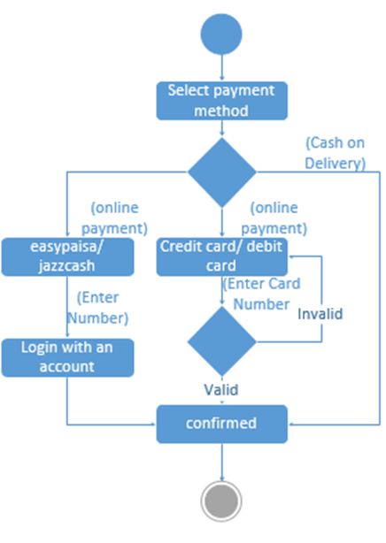
4. State Diagram For Make Payment

Slide 26
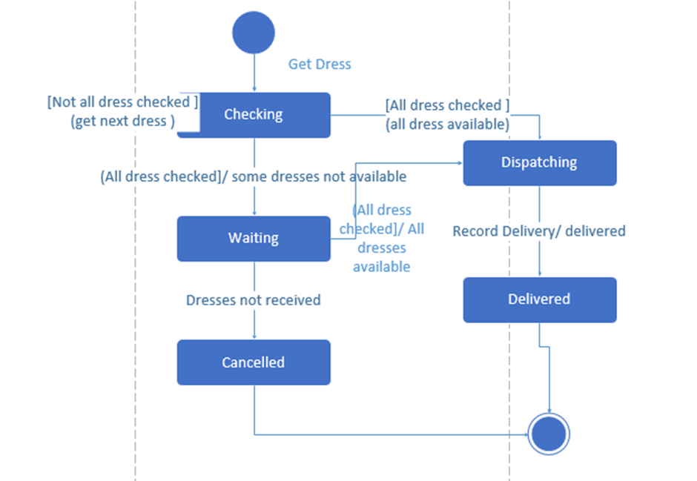
5. State Diagram For Deliver Order

Slide 27
Sequence Diagram
In this section we will discuss the sequence diagram generated from pre designed activity diagram of dress management system. Sequence Diagram visualizes how each activity is performed in core.

Slide 28
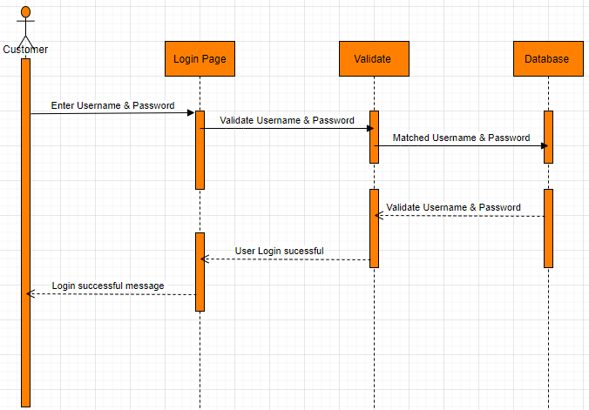
1. Sequences Diagram For Login

Slide 29
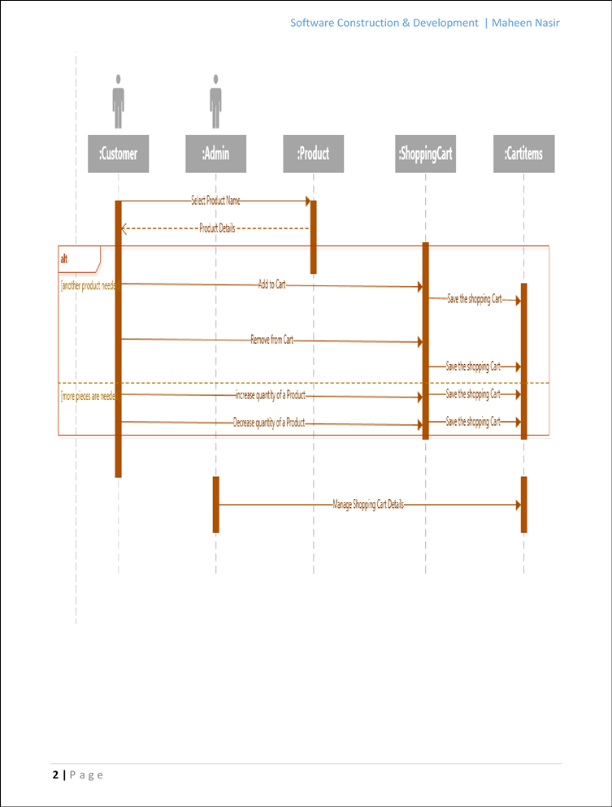
2. Sequences Diagram For Manage Cart

Slide 30
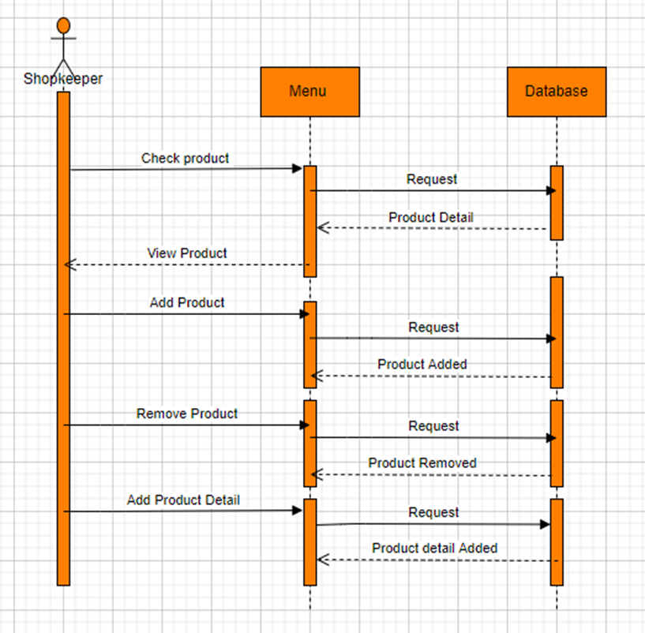
3. Sequences Diagram For Manage Product

Slide 31
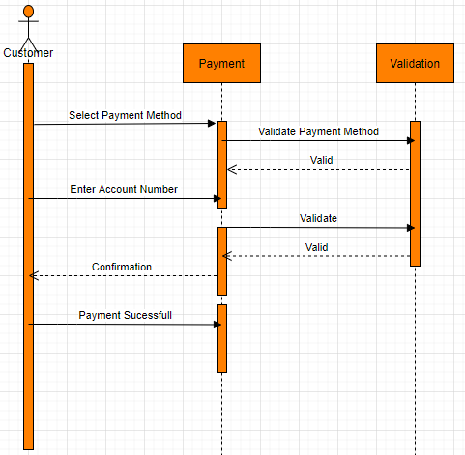
4. Sequences Diagram For Place Order

Slide 32
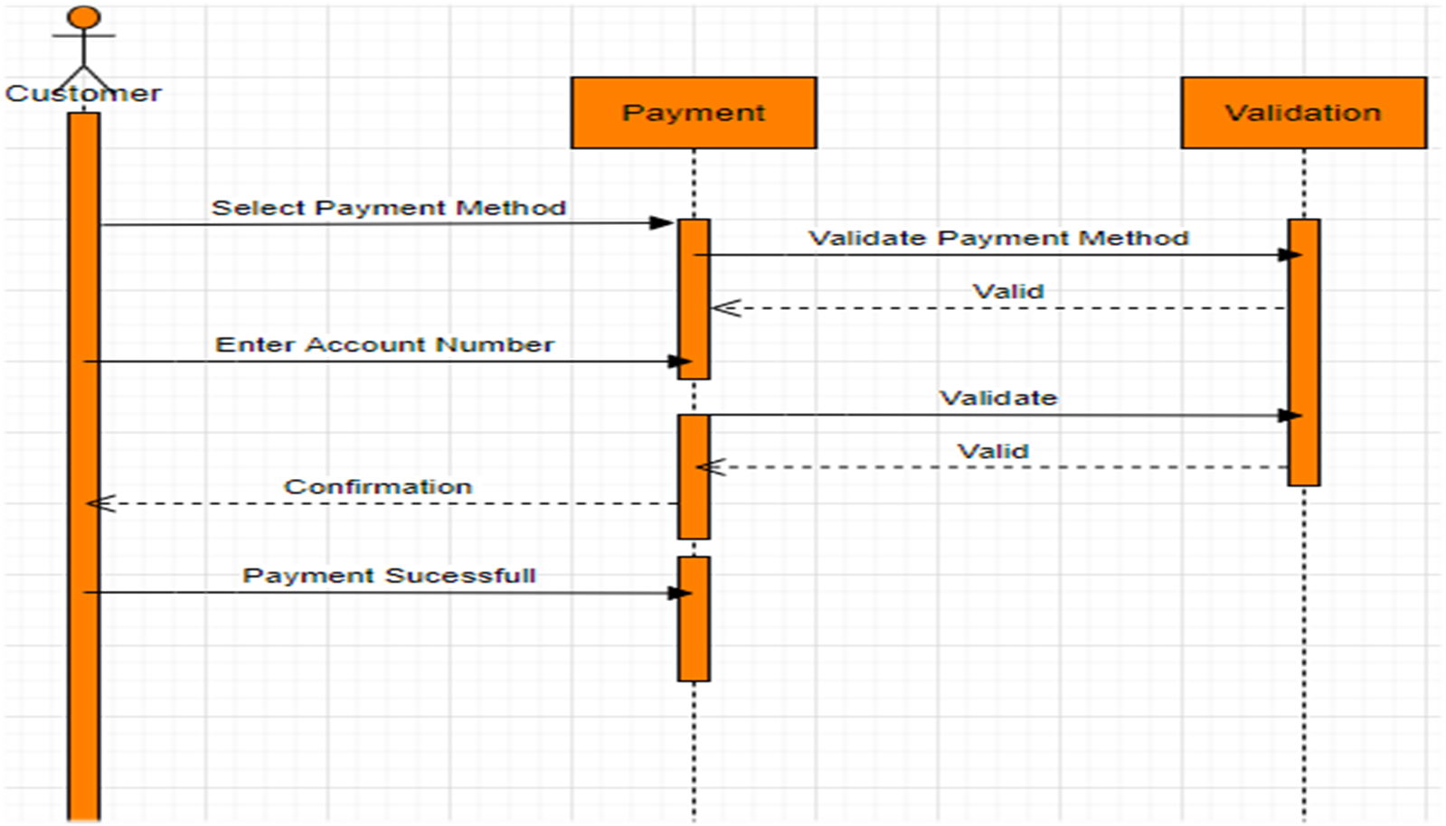
5. Sequences Diagram For Make Payment

Slide 33
Petri Nets
In this section we will discuss Petri Nets of our system. Petri Nets describe complex procedures and model the working of a System.

Slide 34
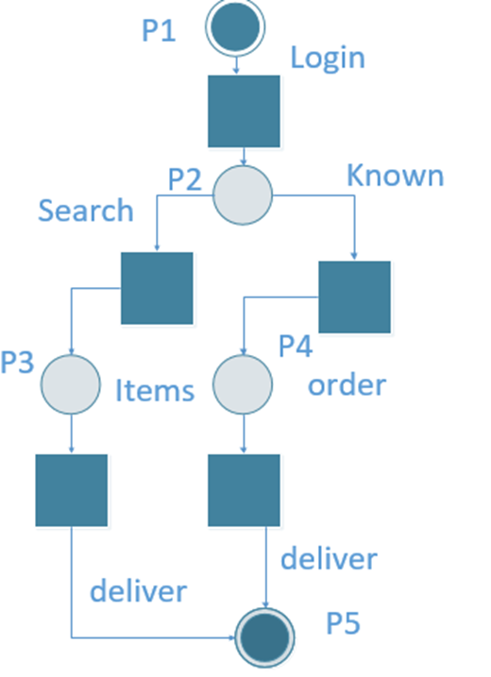

Slide 35


